Slide 1
Software Processes and Process Models

Slide 2
contents
Software processes
Process model
A generic process model
Process flow
Software framework activities
Process Improvement
Software process model
Selection of software process model

Slide 3
Software process
A structured set of activities required to develop a software system.
A framework for the activities, actions, and tasks that are required to build high-quality software.
It is not equal to software engineering, which also encompasses technologies that populate the process– technical methods and automated tools
Many different software processes but all involve:
Specification – defining what the system should do;
Design and implementation – defining the organization of the system and implementing the system;
Validation – checking that it does what the customer wants;
Evolution – changing the system in response to changing customer needs.

Slide 4
Software process descriptions
When we describe and discuss processes, we usually talk about the activities in these processes such as specifying a data model, designing a user interface, etc. and the ordering of these activities.
Process descriptions may also include:
Products, which are the outcomes of a process activity;
Roles, which reflect the responsibilities of the people involved in the process;
Pre- and post-conditions, which are statements that are true before and after a process activity has been enacted or a product produced.

Slide 5
Software Process model
A software process model is an abstract representation of a process.
It presents a description of a process from some particular perspective.
It describes the sequence of phases for the entire lifetime of a product.
Therefore, it is sometimes also called product life cycle.
This covers everything from the initial commercial idea until the final de-installation or disassembling of the product after its use.

Slide 6
What/Who/why is process models?
What: go through a series of predictable steps--- a road map that helps you create a timely, high-quality results.
Who: software engineers and their managers, clients also. people adapt the process to their needs and follow it.
Why: provides stability, control, and organization to an activity that can if left uncontrolled, become quite chaotic. however, modern software engineering approaches must be agile and demand only those activities, controls and work products that are appropriate.
What work products: programs, documents, and data
What are the steps: the process you adopt depends on the software that you are building. one process might be good for aircraft avionic system, while an entirely different process would be used for website creation.
How to ensure right: a number of software process assessment mechanisms that enable us to determine the maturity of the software process. however, the quality, timeliness and long-term viability of the software are the best indicators of the efficacy of the process you use.

Slide 7
A generic process model
As we discussed before, a generic process framework for software engineering defines five framework activities: communication, planning, modeling, construction, and deployment.
In addition, a set of umbrella activities- project tracking and control, risk management, quality assurance, configuration management, technical reviews, and others are applied throughout the process.

Slide 8
Contd…
Communication : this activity involves heavy communication with customers and other stakeholders in order to gather requirements and other related activities.
Planning : here a plan to be followed will be created which will describe the technical tasks to be conducted, risks, required resources, work schedule etc.
Modeling : a model will be created to better understand the requirements and design to achieve these requirements.
Construction : here the code will be generated and tested.
Deployment : here, a complete or partially complete version of the software is represented to the customers to evaluate and they give feedbacks based on the evaluation.

Slide 9

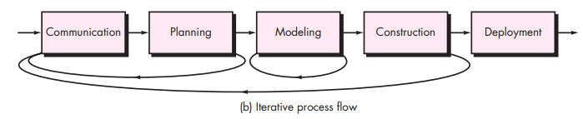
Process flow
A linear process flow executes each of the five activities in sequence.
An iterative process flow repeats one or more of the activities before proceeding to the next.

Slide 10
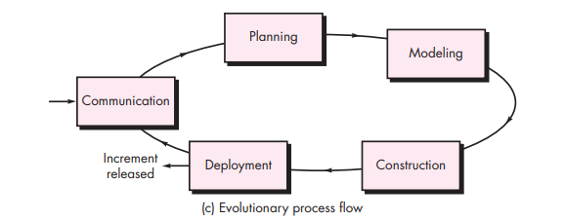
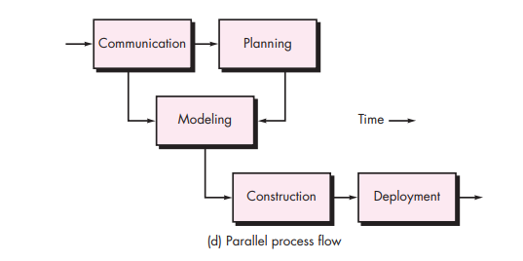
Contd…
An evolutionary process flow executes the activities in a circular manner.
Each circle leads to a more complete version of the software.
A parallel process flow executes one or more activities in parallel with other activities modeling for one aspect of the software in parallel with construction of another aspect of the software.

Slide 11
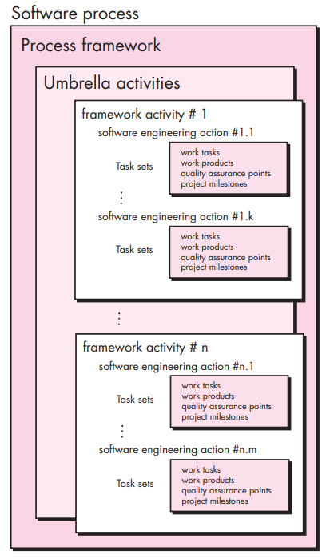
A Generic Process model

Slide 12
Identifying a task set
A task set defines the actual work to be done to accomplish the objectives of a software engineering action.
a list of the task to be accomplished
a list of the work products to be produced
a list of the quality assurance filters to be applied

Slide 13
Contd…
For example, a small software project requested by one person with simple requirements, the communication activity might encompass little more than a phone call with the stakeholder. therefore, the only necessary action is phone conversation, the work tasks of this action are:
Make contact with stakeholder via telephone.
Discuss requirements and take notes.
Organize notes into a brief written statement of requirements.
E-mail to stakeholder for review and approval

Slide 14
CONTD…
The task sets for requirements gathering action for a simple project may include:
Make a list of stakeholders for the project.
Invite all stakeholders to an informal meeting.
Ask each stakeholder to make a list of features and functions required.
Discuss requirements and build a final list.
Prioritize requirements.
Note areas of uncertainty.

Slide 15
Contd…
The task sets for requirements gathering action for a big project may include:
make a list of stakeholders for the project.
interview each stakeholders separately to determine overall wants and needs.
build a preliminary list of functions and features based on stakeholder input.
schedule a series of facilitated application specification meetings.
conduct meetings.
produce informal user scenarios as part of each meeting.
refine user scenarios based on stakeholder feedback.
build a revised list of stakeholder requirements.
use quality function deployment techniques to prioritize requirements.
package requirements so that they can be delivered incrementally.
note constraints and restrictions that will be placed on the system.
discuss methods for validating the system.

Slide 16
Process patterns
A process pattern
describes a process-related problem that is encountered during software engineering work,
identifies the environment in which the problem has been encountered, and
suggests one or more proven solutions to the problem.
Stated in more general terms, a process pattern provides you with a template [amb98]—a consistent method for describing problem solutions within the context of the software process.

Slide 17
Contd…
task patterns—defines a problem associated with a software engineering action or work task and relevant to successful software engineering practice (e.g., requirementsgathering is a task pattern).
stage patterns—defines a problem associated with a framework activity for the process. an example of a stage pattern might be establishingcommunication. this pattern would incorporate the task pattern requirementsgathering and others
phase patterns—define the sequence of framework activities that occur with the process, even when the overall flow of activities is iterative in nature. an example of a phase pattern might be spiralmodel or prototyping.

Slide 18
Contd…
template for describing a process pattern:
pattern name:
the pattern name is given a meaningful name that describe its function within software process.
example: customer-communication
intent:
the objective of this pattern is describe briefly.
example: intent of the communication customer to connection establish with customer.
type:
the pattern type is specified.
three types:
task pattern - action or work task;
stage pattern – frame activity; and
phase pattern – sequence of frame.

Slide 19
CONTD…
Initial Context:
describe which pattern are applies prior to the initialization of the pattern.
what organizational or team-related activities have already occurred?
what is the entry state for the process?
what software engineering information or project information already exists?
for example, the planning pattern (a stage pattern) requires that
customers and software engineers have established a collaborative communication;
successful completion of a number of task patterns [specified] for the communication pattern has occurred; and
the project scope, basic business requirements, and project constraints are known

Slide 20
Contd…
problem.
the specific problem to be solved by the pattern.
solution.
describes how to implement the pattern successfully. this section describes how the initial state of the process (that exists before the pattern is implemented) is modified as a consequence of the initiation of the pattern.
it also describes how software engineering information or project information that is available before the initiation of the pattern is transformed as a consequence of the successful execution of the pattern.

Slide 21
Contd…
resulting context:
the condition that will result once the pattern has been successfully implementers are describe.
upon completion of the pattern:
what organizational or team-related activities must have occurred?
what is the exit state for the process?
what software engineering information or project information has been developed?

Slide 22
Contd…
related pattern:
a list of process pattern that are directly related to this one are provided as a hierarchy on in some other diagrammatic form.
for example, the stage pattern communication encompasses the task patterns: projectteam, collaborativeguidelines, scopeisolation, requirementsgathering, constraintdescription, and scenariocreation.
known uses and examples:
indicate the specific instances in which the pattern is applicable.
for example, communication is mandatory at the beginning of every software project, is recommended throughout the software project, and is mandatory once the deployment activity is under way.

Slide 23
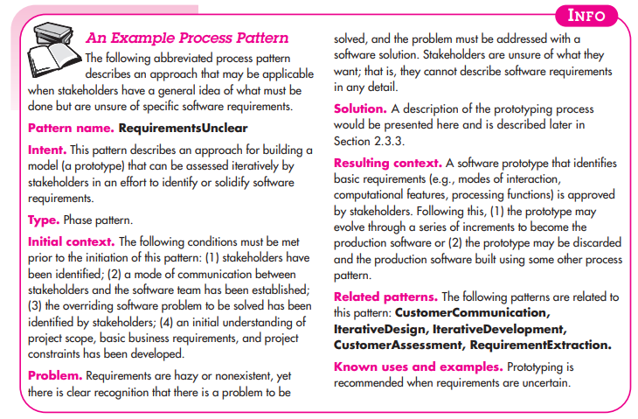

Slide 24
Process improvement
Many software companies have turned to software process improvement as a way of enhancing the quality of their software, reducing costs or accelerating their development processes.
Process improvement means understanding existing processes and changing these processes to increase product quality and/or reduce costs and development time.

Slide 25
Approaches to improvement
The process maturity approach, which focuses on improving process and project management and introducing good software engineering practice.
The level of process maturity reflects the extent to which good technical and management practice has been adopted in organizational software development processes.
The agile approach, which focuses on iterative development and the reduction of overheads in the software process.
The primary characteristics of agile methods are rapid delivery of functionality and responsiveness to changing customer requirements.

Slide 26
The process improvement cycle

Slide 27
Process improvement activities
process measurement
you measure one or more attributes of the software process or product. these measurements forms a baseline that helps you decide if process improvements have been effective.
process analysis
the current process is assessed, and process weaknesses and bottlenecks are identified. process models (sometimes called process maps) that describe the process may be developed.
process change
process changes are proposed to address some of the identified process weaknesses. these are introduced and the cycle resumes to collect data about the effectiveness of the changes.

Slide 28
Process measurement
Wherever possible, quantitative process data should be collected
however, where organisations do not have clearly defined process standards this is very difficult as you don’t know what to measure.
a process may have to be defined before any measurement is possible.
Process measurements should be used to assess process improvements
but this does not mean that measurements should drive the improvements.
the improvement driver should be the organizational objectives.

Slide 29
Process metrics
Time taken for process activities to be completed
e.g. calendar time or effort to complete an activity or process.
Resources required for processes or activities
e.g. total effort in person-days.
Number of occurrences of a particular event
e.g. number of defects discovered.

Slide 30
Capability maturity levels

Slide 31
The SEI capability maturity model
initial
essentially uncontrolled
repeatable
product management procedures defined and used
defined
process management procedures and strategies defined and used
managed
quality management strategies defined and used
optimising
process improvement strategies defined and used

Slide 32
Process Assessment and improvement
Standard cmmi assessment method for process improvement (SCAMPI) — provides a five step process assessment model that incorporates five phases: initiating, diagnosing, establishing, acting and learning.
CMM-based appraisal for internal process improvement (CBA IPI)—provides a diagnostic technique for assessing the relative maturity of a software organization; uses the sei cmm as the basis for the assessment [dun01]
spice—the spice (iso/iec15504) standard defines a set of requirements for software process assessment. the intent of the standard is to assist organizations in developing an objective evaluation of the efficacy of any defined software process. [iso08]
iso 9001:2000 for software—a generic standard that applies to any organization that wants to improve the overall quality of the products, systems, or services that it provides. therefore, the standard is directly applicable to software organizations and companies. [ant06]

Slide 33
Personal Software Process (PSP)
planning. this activity isolates requirements and develops both size and resource estimates. in addition, a defect estimate (the number of defects projected for the work) is made. all metrics are recorded on worksheets or templates. finally, development tasks are identified and a project schedule is created.
high-level design. external specifications for each component to be constructed are developed and a component design is created. prototypes are built when uncertainty exists. all issues are recorded and tracked.
high-level design review. formal verification methods (chapter 21) are applied to uncover errors in the design. metrics are maintained for all important tasks and work results.
development. the component level design is refined and reviewed. code is generated, reviewed, compiled, and tested. metrics are maintained for all important tasks and work results.
postmortem. using the measures and metrics collected (this is a substantial amount of data that should be analyzed statistically), the effectiveness of the process is determined. measures and metrics should provide guidance for modifying the process to improve its effectiveness.

Slide 34
Team Software Process (TSP)
Build self-directed teams that plan and track their work, establish goals, and own their processes and plans. these can be pure software teams or integrated product teams (ipt) of three to about 20 engineers.
Show managers how to coach and motivate their teams and how to help them sustain peak performance.
Accelerate software process improvement by making CMM level 5 behavior normal and expected.
the capability maturity model (cmm), a measure of the effectiveness of a software process.
Provide improvement guidance to high-maturity organizations.

Slide 35
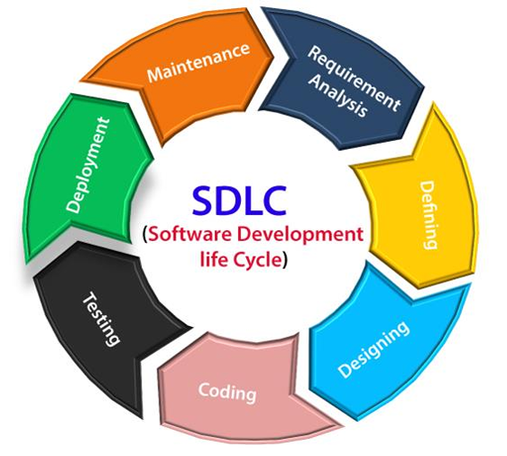
Software Development life cycle (SDLC)

Slide 36
Prescriptive process models
Prescriptive process models advocate an orderly approach to software engineering
that leads to a few questions …
If prescriptive process models strive for structure and order, are they inappropriate for a software world that thrives on change?
Yet, if we reject traditional process models (and the order they imply) and replace them with something less structured, do we make it impossible to achieve coordination and coherence in software work?

Slide 37
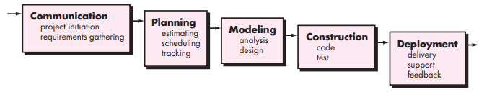
Waterfall model

Slide 38
Contd…
The first published model of the software development process was derived from more general system engineering processes (royce, 1970).
This model is known as the ‘waterfall model’ or software life cycle
The waterfall model this takes the fundamental process activities of specification, development, validation, and evolution and represents them as separate process phases such as requirements specification, software design, implementation, testing, and so on.

Slide 39
CONTd…
Problems:
Real projects rarely follow the sequential flow that the model proposes. although the linear model can accommodate iteration, it does so indirectly. as a result, changes can cause confusion as the project team proceeds.
It is often difficult for the customer to state all requirements explicitly. the waterfall model requires this and has difficulty accommodating the natural uncertainty that exists at the beginning of many projects.
The customer must have patience. a working version of the program(s) will not be available until late in the project time span. a major blunder, if undetected until the working program is reviewed, can be disastrous

Slide 40
Contd…
problems:
rarely linear, iteration needed.
hard to state all requirements explicitly. blocking state.
code will not be released until very late.
waterfall model application
every software developed is different and requires a suitable sdlc approach to be followed based on the internal and external factors. some situations where the use of waterfall model is most appropriate are:
requirements are very well documented, clear and fixed.
product definition is stable.
technology is understood and is not dynamic.
there are no ambiguous requirements.
ample resources with required expertise are available to support the product.
the project is short.

Slide 41
Contd…
Some circumstances where the use of the waterfall model is most suited are:
When the requirements are constant and not changed regularly.
A project is short
The situation is calm
Where the tools and technology used is consistent and is not changing
When resources are well prepared and are available to use.

Slide 42
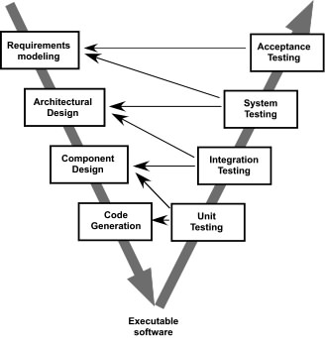
The V-Model

Slide 43
The Incremental Model

Slide 44
Evolutionary Models: Prototyping
Quick
plan
communication
Modeling
Quick design
Deployment
delivery &
feedback
Construction
of prototype
Construction
of prototype

Slide 45
Evolutionary Models: The Spiral

Slide 46
Evolutionary Models: Concurrent

Slide 47
Still Other Process Models
Component based development—the process to apply when reuse is a development objective
Formal methods—emphasizes the mathematical specification of requirements
AOSD—provides a process and methodological approach for defining, specifying, designing, and constructing aspects
Unified Process—a “use-case driven, architecture-centric, iterative and incremental” software process closely aligned with the Unified Modeling Language (UML)

Slide 48
The Unified Process
Why a Process?
Software projects are large, complex, sophisticated
time to market is key
many facets involved in getting to the end
Common process should
integrate the many facets
provide guidance to the order of activities
specify what artifacts need to be developed
offer criteria for monitoring and measuring a project

Slide 49
The Unified Process
Component based - meaning the software system is built as a set of software components interconnected via interfaces
Uses the Unified Modeling Language (UML)
Use case driven
Architecture-centric
Iterative and incremental
This is what makes
the Unified process
Unique
Component: A physical and replaceable part of a system that conforms to
and provides realization of a set of interfaces.
Interface: A collection of operations that are used to specify a service of a class or a component

Slide 50
The Unified Process
User’s
requirements
Software
Development
Process
Software
System

Slide 51
The Unified Process
Use Case driven
A use case is a piece of functionality in the system that gives a user a result of value
Use cases capture functional requirements
Use case answers the question: What is the system supposed to do for the user?

Slide 52
The Unified Process
Architecture centric
similar to architecture for building a house
Embodies the most significant static and dynamic aspects of the system
Influenced by platform, OS, DBMS etc.
Primarily serves the realization of use cases

Slide 53
The Unified Process
Iterative and Incremental
commercial projects continue many months and years
to be most effective - break the project into iterations
Every iteration - identify use cases,create a design, implement the design
Every iteration is a complete development process

Slide 54
The Life of the Unified Process
Unified process repeats over a series of cycles
Each cycle concludes with a product release
Each cycle consists of four phases:
inception
elaboration
construction
transition

Slide 55
The Unified Process (UP)
elaboration
inception

Slide 56
Contd…
Inception –
Communication and planning are main.
Identifies Scope of the project using use-case model allowing managers to estimate costs and time required.
Customers requirements are identified and then it becomes easy to make a plan of the project.
Project plan, Project goal, risks, use-case model, Project description, are made.
Project is checked against the milestone criteria and if it couldn’t pass these criteria then project can be either cancelled or redesigned.

Slide 57
Elaboration –
Planning and modeling are main.
Detailed evaluation, development plan is carried out and diminish the risks.
Revise or redefine use-case model (approx. 80%), business case, risks.
Again, checked against milestone criteria and if it couldn’t pass these criteria then again project can be cancelled or redesigned.
Executable architecture baseline.

Slide 58
Construction –
Project is developed and completed.
System or source code is created and then testing is done.
Coding takes place.

Slide 59
Transition –
Final project is released to public.
Transit the project from development into production.
Update project documentation.
Beta testing is conducted.
Defects are removed from project based on feedback from public.

Slide 60
The Life of the Unified Process
Time
Inception
Elaboration
Construction
Transition
Iteration
Iteration
Iteration
Iteration
Iteration
Iteration
Iteration
Iteration
1
1
1
1
Release 1
A cycle with its phases and its iterations

Slide 61
UP Phases

Slide 62
UP Work Products

Slide 63
Selection of a process model
Selection of a model is based on:
Requirements
Development team
Users
Project type and associated risk

Slide 64
Thank you!!!

